Slide 1

Machine Learning Presentation On Heart Disease Classification Dataset
By: Aditya Raj Kashyap(2K22/SE/09)
Adarsh Kr. Jha(2k22/SE/06)
Abdulrahman (2K22/SE/03)

Slide 2
INDEX
S No. | TITLE | PAGE NO
1 | Dataset Review | 4
2 | Data Preprocessing | 5
3 | Data Preprocessing Techniques | 6-15
4 | Intro to Confusion matrix | 16
5 | Performance measure by Confusion matrix | 17-23
6 | Intro to Machine learning models | 24
7 | ID3 | 26
8 | C4.5 | 28
9 | CART | 30
10 | KNN | 32
11 | Naïve Bias | 39
12 | Random Forest | 43
13 | XG- Boost | 47
14 | Neural Network | 51
15 | ROC-AUC Curve | 54
16 | Advantage of ROC-AUC | 58
17 | Application Of ROC-AUC | 59
18 | Graph for performance comparison measure | 60
19 | Thank You | 61

Slide 3

MOTIVATION
Heart disease remains one of the leading causes of mortality worldwide, imposing a significant burden on individuals, families, and healthcare systems. Despite advancements in medical technology and treatment options, timely and accurate diagnosis of heart disease continues to be a challenge. Traditional diagnostic methods often rely on subjective assessments and are prone to human error, leading to delays in intervention and suboptimal patient outcomes.
In this context, the application of machine learning techniques offers a promising avenue for improving the accuracy and efficiency of heart disease diagnosis.

Slide 4
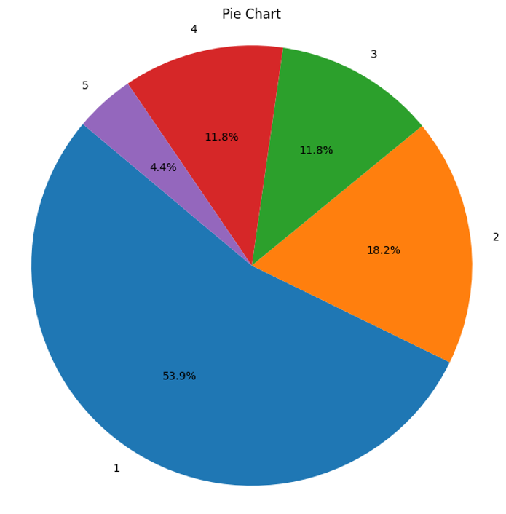
Heart Disease Classification Dataset Overview
Dataset Characteristics:
Multivariate
Subject Area: Health and Medicine
Associated Tasks: Classification
Feature Type: Categorical, Integer, Real
Dataset Information:
Instances: 303
Features: 13
Original Attributes: 76 attributes
Subset Used: 14 attributes
Target Variable (Goal): Presence of heart disease in the patient, integer-valued from 0 (no presence) to 4.
Focus: Experiments primarily aimed at distinguishing presence (values 1, 2, 3, 4) from absence (value 0) of heart disease.
Data Privacy: Names and social security numbers of patients were replaced with dummy values for privacy reasons.
Additional Information:
The dataset primarily focuses on the Cleveland database, which has been extensively used by machine learning researchers.
Test Costs, donated by Peter Turney, are available in the "Costs" folder.
Four unprocessed files exist alongside the processed Cleveland database file.

Slide 5

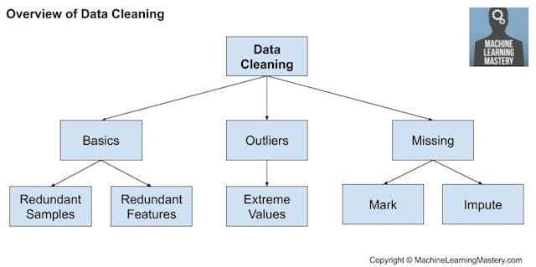
Introduction to Data Preprocessing
Data preprocessing is a crucial step in any data analysis project. It involves cleaning, transforming, and preparing raw data to make it suitable for further analysis and modeling. This sets the foundation for uncovering valuable insights from your data.

Slide 6
Correlation Matrix
What is a Correlation Matrix?
Interpreting Correlation
Use Cases
Correlation matrices are useful for feature selection, multicollinearity detection, and understanding the interplay between variables in a dataset.
A correlation matrix is a table that displays the correlation coefficients between every pair of variables in a dataset. It helps identify relationships and patterns among the variables.
The correlation values range from -1 to 1, where -1 indicates a strong negative relationship, 0 indicates no relationship, and 1 indicates a strong positive relationship.

Slide 7
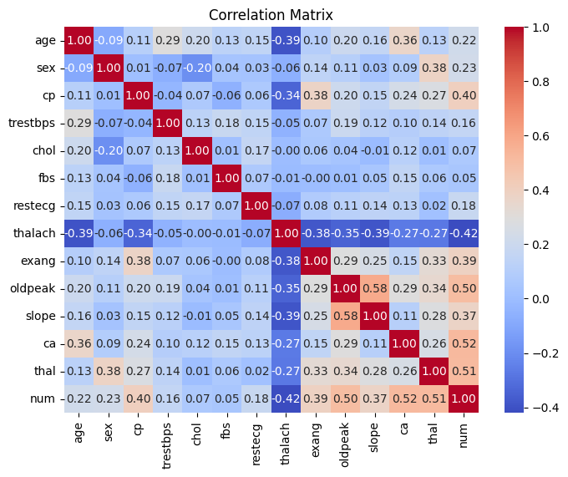
CORRELATION MATRIX (FOR HEART DISEASE CLASSIFICATION DATASET)

Slide 8




Understanding Box Plots
Median
Interquartile Range (IQR)
Whiskers
Outliers
The median represents the middle value in the dataset, dividing the data into two equal halves.
The whiskers extend to the minimum and maximum values, excluding any outliers.
Outliers are data points that lie outside the whiskers, typically more than 1.5 times the IQR.
The IQR is the range between the 25th and 75th percentiles, capturing the middle 50% of the data.

Slide 9
Box Plot Visualization
What is a Box Plot?
Understanding the Elements
A box plot is a graphical representation that displays the distribution of a dataset. It shows the median, the interquartile range (IQR), and any outliers.
The box represents the IQR, the line inside the box is the median, and the whiskers extend to the minimum and maximum values (excluding outliers).
Identifying Outliers
Comparing Distributions
Box plots are particularly useful for identifying outliers, which are data points that lie outside the whiskers (typically more than 1.5 times the IQR).
Box plots allow for easy comparison of the distribution of data across different groups or variables, making them a powerful tool for exploratory data analysis.

Slide 10
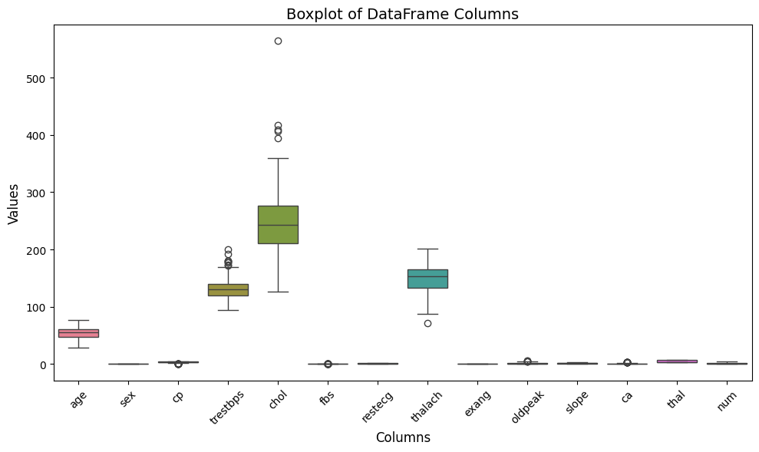
BOXPLOT (FOR HEART DISEASE CLASSIFICATION DATASET)

Slide 11
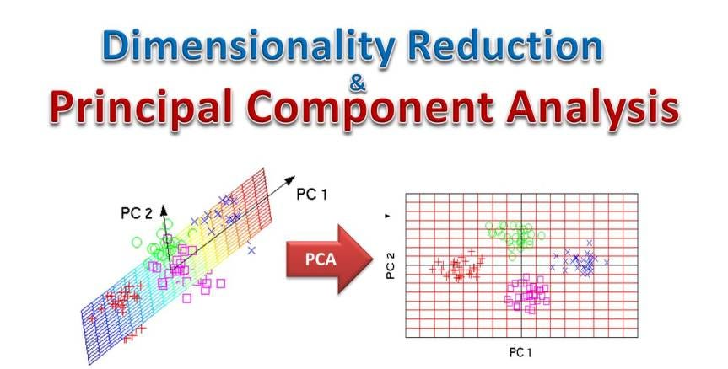

Slide 12
Principal Component Analysis (PCA)
Dimension Reduction
1
PCA is a technique that reduces the dimensionality of a dataset by transforming the original variables into a smaller set of uncorrelated principal components.
2
Identifying Patterns
PCA helps uncover hidden patterns and structures in high-dimensional data by finding the directions of maximum variance.
Visualization
3
The principal components can be used to create visualization.

Slide 13
Interpreting the PCA Results
Explained Variance Ratio
Loading Scores
Scatter Plots
The loading scores represent the contribution of each original variable to the principal components. These can be used to understand the relationships between the variables and the components.
Visualizing the data in the principal component space can reveal patterns, clusters, and outliers that may not be evident in the original high-dimensional space.
The explained variance ratio indicates the proportion of variance in the data that is accounted for by each principal component. This helps determine the optimal number of components to retain.

Slide 14



Upsampling Techniques
Random Oversampling
SMOTE
ADASYN
Synthetic Minority Over-sampling Technique: Creating new synthetic instances of the minority class.
Adaptive Synthetic Sampling Approach: Generating minority class samples based on their difficulty to learn.
Randomly duplicating instances of the minority class to balance the dataset.

Slide 15
Conclusion and Key Takeaways
1
Data Preprocessing is Crucial
2
Correlation and PCA Provide Insights
Cleaning, transforming, and preparing data sets the foundation for effective analysis and modeling.
Correlation matrices and Principal Component Analysis can uncover relationships and patterns in high-dimensional data.
3
Box Plots Reveal Distribution
4
Upsampling Balances Datasets
Box plots are a powerful tool for visualizing and understanding the distribution of data, including outliers.
Techniques like Random Oversampling, SMOTE, and ADASYN can help address class imbalance in datasets.

Slide 16
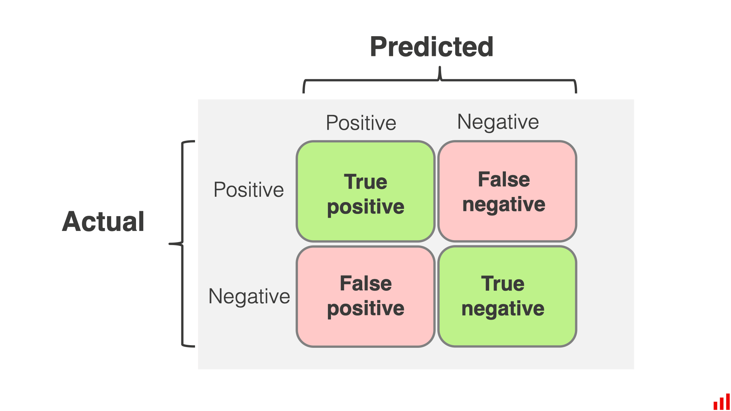
Introduction to Confusion Matrix
The confusion matrix is a powerful tool used to evaluate the performance of a classification model. It provides a comprehensive view of how well the model is performing by comparing the predicted labels to the true labels.
Aa
by Adarsh Jha

Slide 17
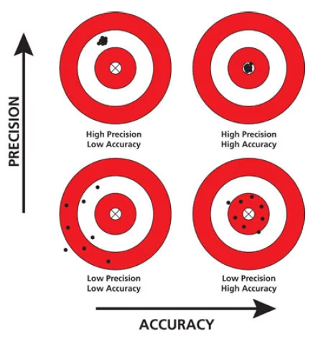
Understanding Accuracy
1
Accuracy
2
High Accuracy
Measures the overall proportion of correct predictions made by the model.
Indicates the model is performing well and making accurate predictions.
3
Limitations
Accuracy alone may not tell the whole story, as it does not capture nuances like precision and recall.

Slide 18
Understanding Precision
1
Precision
2
High Precision
3
Importance
Measures the proportion of true positive predictions out of all positive predictions made by the model.
Indicates the model is making very few false positive predictions.
Precision is crucial when the cost of a false positive is high, such as in medical diagnoses.

Slide 19
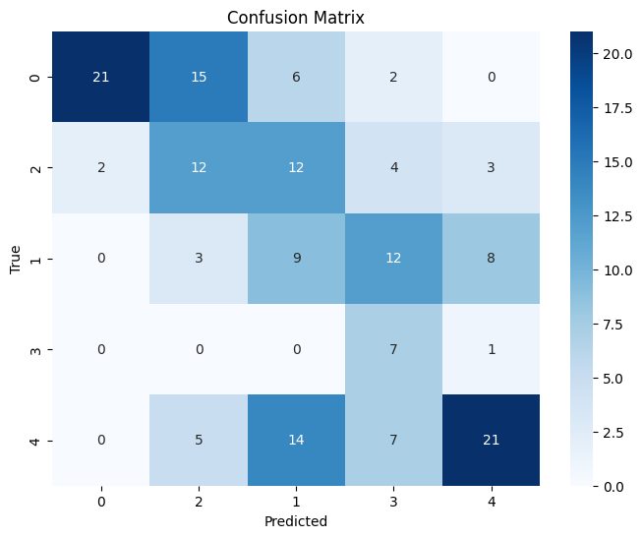
CONFUSION MATRIX (Artificial Neural Network WITH UPSAMPLING)

Slide 20
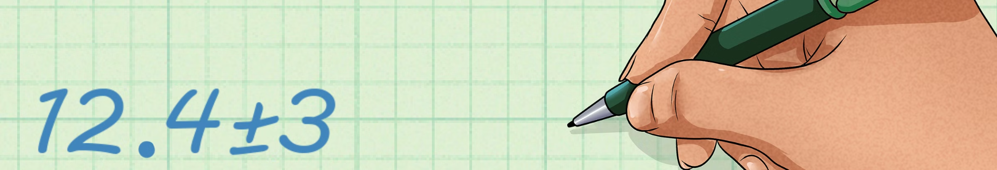
Calculating Precision
Step 1
1
Identify the true positive and false positive values from the confusion matrix.
2
Step 2
Divide the true positive value by the sum of true positive and false positive values.
Step 3
3
The result is the precision of the model.

Slide 21
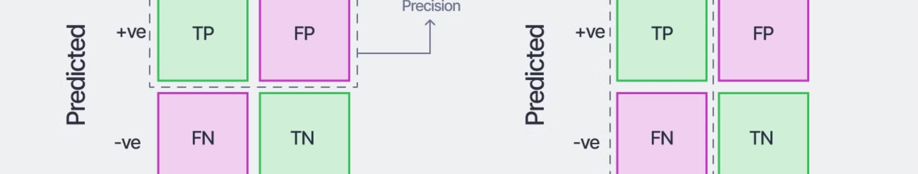
Understanding Recall
1
Recall
2
High Recall
3
Importance
Measures the proportion of true positive predictions out of all actual positive instances.
Indicates the model is able to identify most of the positive instances correctly.
Recall is crucial when the cost of a false negative is high, such as in fraud detection.

Slide 22

Calculating Recall
1
Step 1
Identify the true positive and false negative values from the confusion matrix.
2
Step 2
Divide the true positive value by the sum of true positive and false negative values.
3
Step 3
The result is the recall of the model.

Slide 23

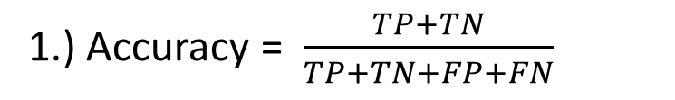
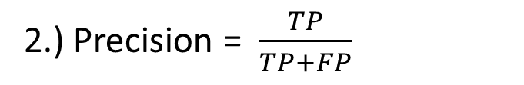
Formula for calculating performance measure in machine learning
1.) Accuracy = $\frac{TP+TN}{TP+TN+FP+FN}$
2.) Precision = $\frac{TP}{TP+FP}$
3.) Recall = $\frac{TP}{TP+FN}$
4.) Specificity = $\frac{TN}{TN+FP}$

Slide 24

Introduction to Machine Learning Models
Machine learning is a rapidly evolving field that has revolutionized the way we approach problem-solving. This presentation will explore four key machine learning algorithms - ID3, C4.5, CART, and KNN - and their unique applications and strengths.
Aa

Slide 25
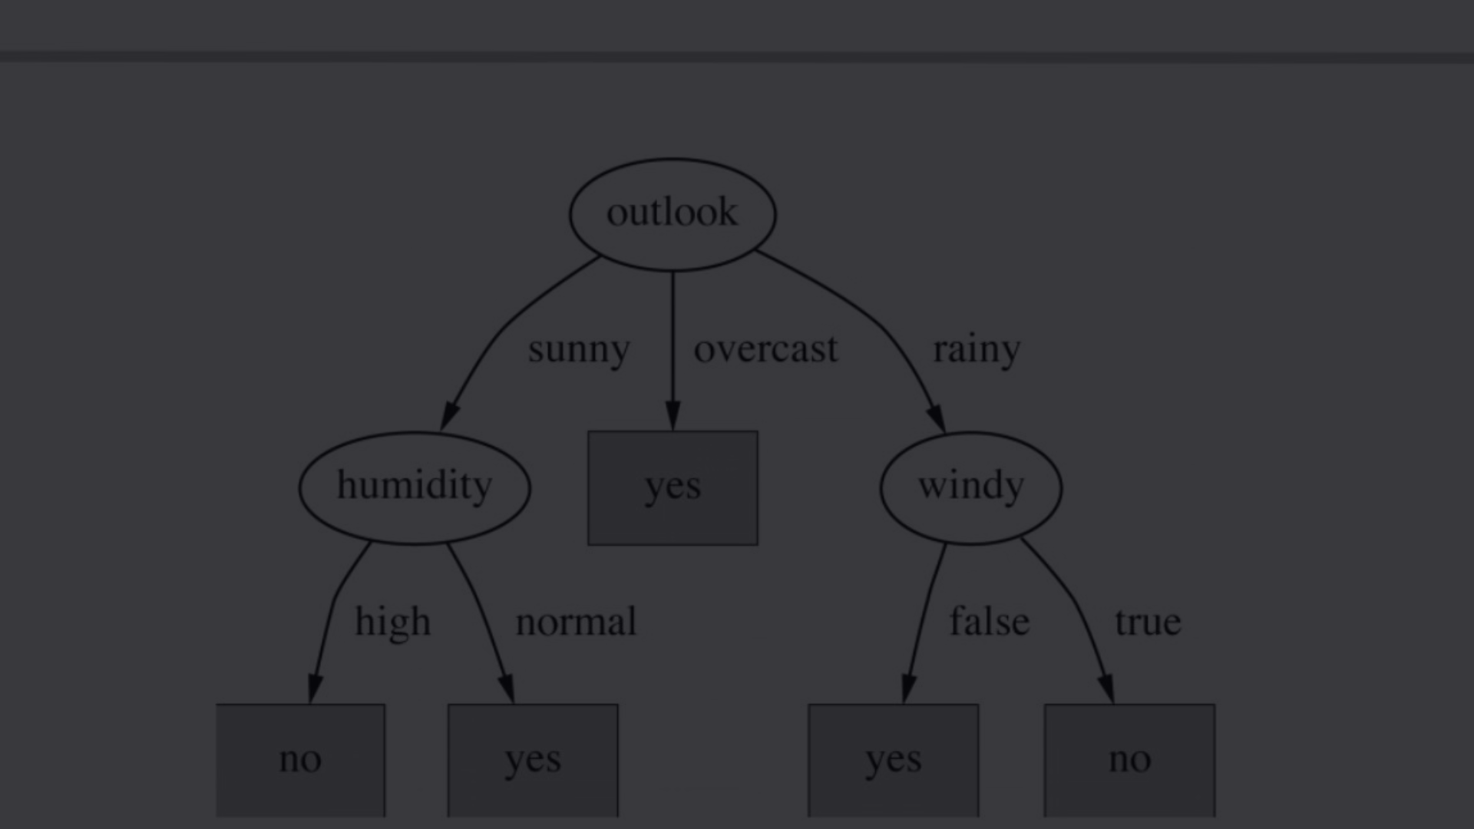
Decision Tree Algorithms
ID3 Algorithm
C4.5 Algorithm
CART Algorithm
The ID3 (Iterative Dichotomiser 3) algorithm is a popular decision tree learning algorithm that uses information gain to select the most informative feature at each node.
C4.5 is an extension of the ID3 algorithm that addresses some of its limitations, such as handling continuous and missing values, and pruning the decision tree to improve generalization.
The Classification and Regression Tree (CART) algorithm is a decision tree learning method that can be used for both classification and regression tasks, offering flexibility in problem-solving.

Slide 26
ID3 Algorithm
1
Information Gain
The ID3 algorithm selects the feature that provides the highest information gain at each node, ensuring the most informative split.
2
Recursive Partitioning
The algorithm recursively partitions the data, creating a hierarchical decision tree that can accurately classify new instances.
3
Entropy Minimization
ID3 aims to minimize the entropy (or uncertainty) of the resulting tree, leading to a compact and efficient model.

Slide 27
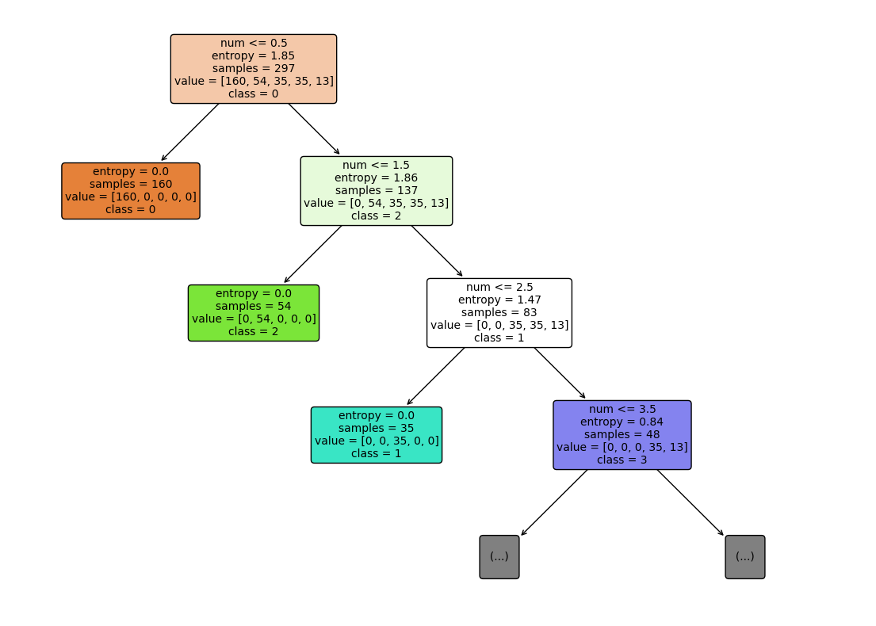
ID3 TREE
Metrics for ID3: Accuracy: 0.9867986798679867 Precision: 0.9818181818181818 Recall: 0.9473684210526315 sensitivity: 0.9473684210526315
Notebook link : https://colab.research.google.com/drive/13r86rOJnmENV705-JglWd1Hlwpqpvlpu?usp=sharing

Slide 28
C4.5 Algorithm
Handling Continuous Attributes
Pruning for Generalization
Missing Value Handling
C4.5 can handle continuous attributes by dynamically determining the best split points, unlike ID3 which requires discretization.
C4.5 employs a post-pruning technique to remove branches that do not significantly contribute to the overall accuracy, improving the model's generalization ability.
C4.5 can effectively handle missing values by using a probabilistic approach, making it more robust to noisy or incomplete data.

Slide 29
C4.5 TREE
Metrics for C4.5: Accuracy: 0.9801980198019802 Precision: 1.0 Recall: 0.9 sensitivity: 0.9
Notebook link : https://colab.research.google.com/drive/13r86rOJnmENV705-JglWd1Hlwpqpvlpu?usp=sharing

Slide 30
Classification and Regression Tree (CART) Algorithm
1
Versatility
2
Binary Splitting
CART can be used for both classification and regression tasks, providing a flexible solution for a wide range of problems.
CART constructs binary decision trees, where each node has at most two child nodes, resulting in a simpler and more interpretable model.
3
Gini Index Optimization
4
Pruning for Overfitting
CART selects the feature that minimizes the Gini index, a measure of impurity, to determine the optimal split at each node.
CART employs pruning techniques to prevent overfitting and improve the model's performance on unseen data.

Slide 31
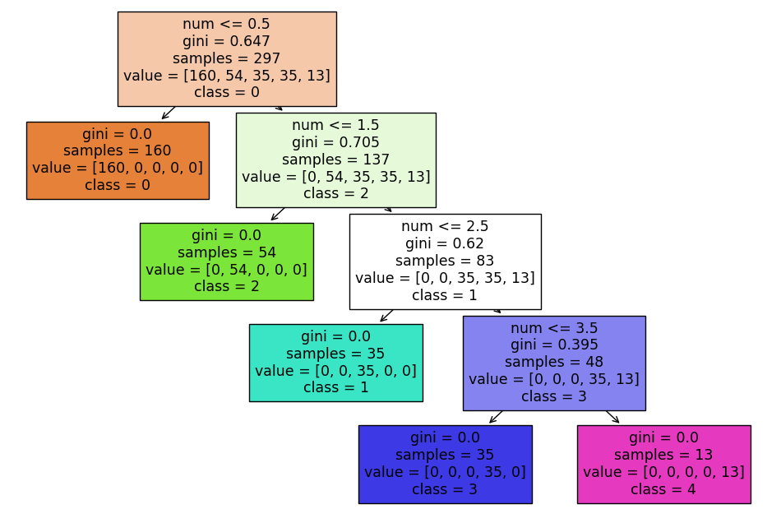
CART TREE
Metrics on C4.5: Accuracy: 1.0 Precision: 1.0 Recall: 1.0
Notebook link : https://colab.research.google.com/drive/13r86rOJnmENV705-JglWd1Hlwpqpvlpu?usp=sharing

Slide 32




K-Nearest Neighbors (KNN) Algorithm
Distance Metric
K-Nearest Neighbors
Majority Voting
Averaging
KNN uses a distance metric, such as Euclidean or Manhattan distance, to determine the similarity between data points.
For classification tasks, KNN assigns the class label based on the majority vote of the K nearest neighbors.
For regression tasks, KNN predicts the target value by averaging the values of the K nearest neighbors.
The algorithm identifies the K nearest neighbors to a given data point and uses their labels to predict the class or value of the new instance.

Slide 33
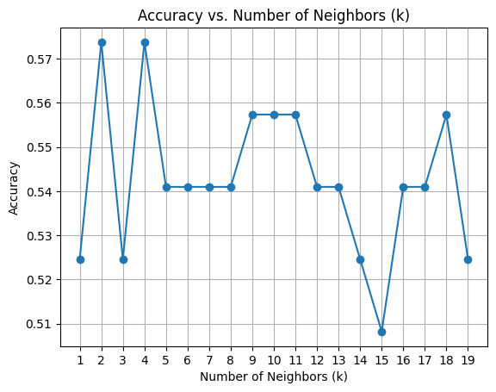
ACCURACY TREND WITH K (KNN WITHOUT UPSAMPLING)

Slide 34
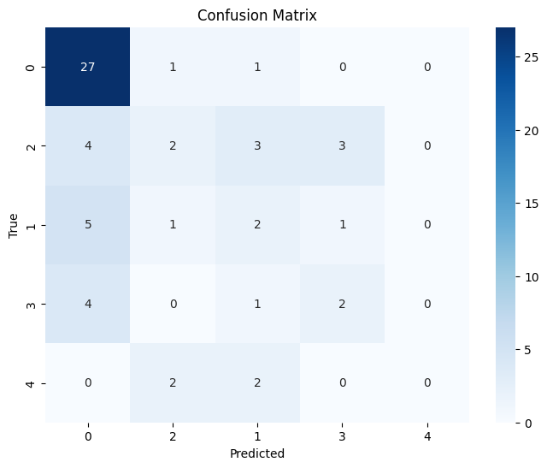
CONFUSION MATRIX (KNN MODEL without up-sampling)

Slide 35
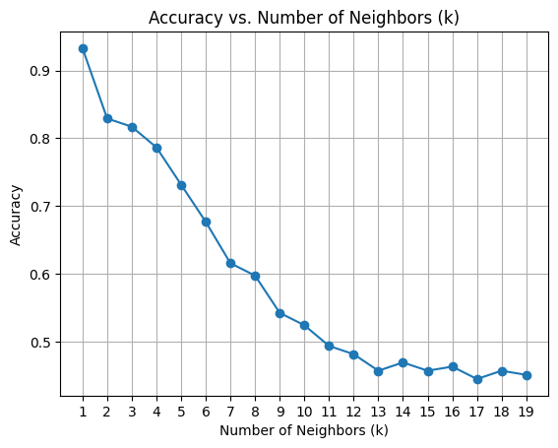
ACCURACY TREND WITH K (KNN WITH UPSAMPLING)

Slide 36
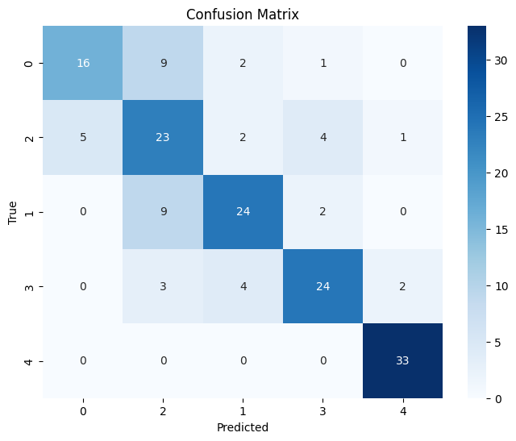
CONFUSION MATRIX (KNN MODEL with up-sampling)

Slide 37
Comparison of Decision Tree and KNN Models
Decision Trees
KNN
Interpretable model structure
Black-box model
Efficient for large datasets
Computationally intensive for large datasets
Can handle both numerical and categorical features
Performs better with numerical features
Prone to overfitting, require pruning
Sensitive to noisy or irrelevant features

Slide 38
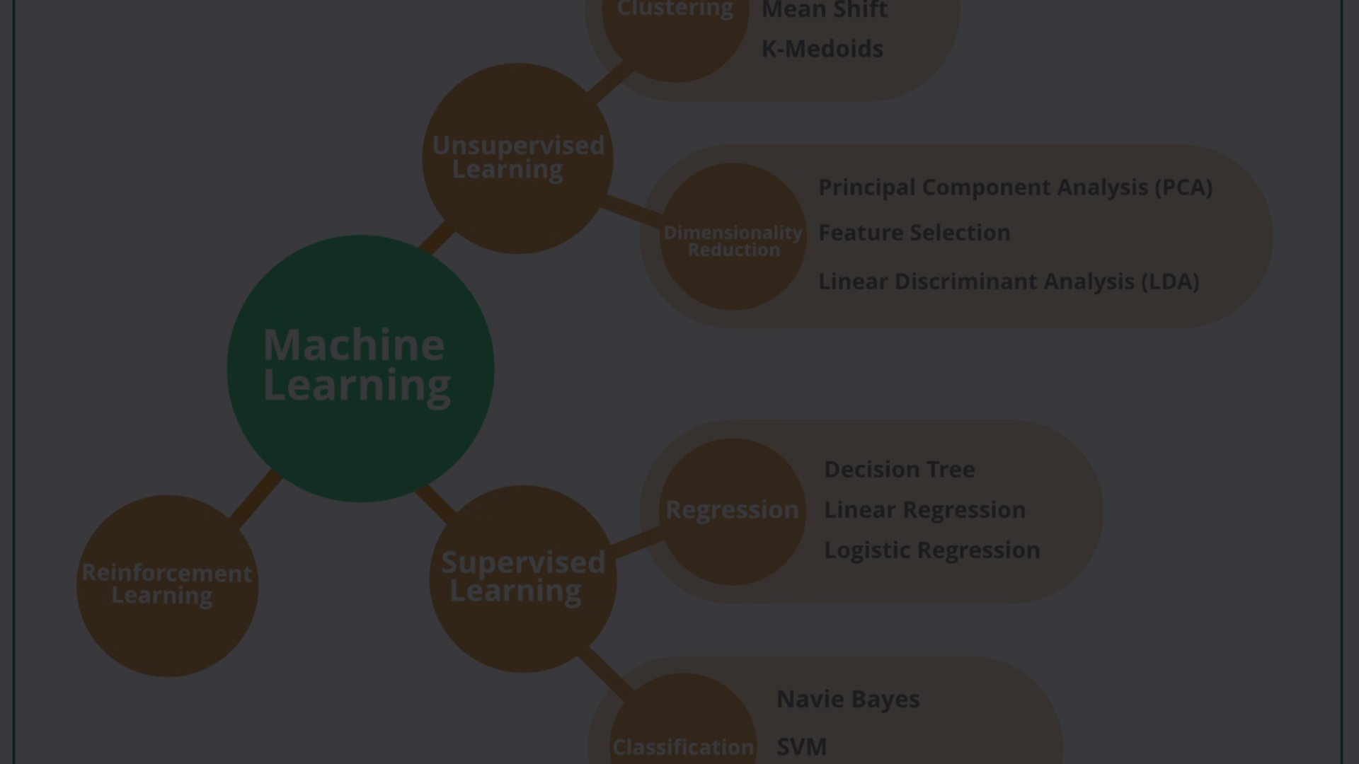
Conclusion and Key Takeaways
Diverse Algorithms
Informed Decision Making
Continuous Learning
The presented machine learning algorithms - ID3, C4.5, CART, and KNN - offer unique strengths and capabilities, catering to a wide range of problem domains.
As the field of machine learning continues to evolve, staying up-to-date with the latest advancements and exploring new techniques is crucial for successful problem-solving.
Understanding the nuances of these algorithms empowers data scientists to make informed choices based on the specific requirements of their projects.

Slide 39


Naive Bayes Model
Probabilistic Classifier
Independence Assumption
Naive Bayes is a simple yet powerful probabilistic classification algorithm that calculates the probability of an outcome based on the input features.
The model assumes that the input features are independent of each other, which simplifies the calculations but can work well in many real-world scenarios.
Fast and Scalable
Naive Bayes is a computationally efficient algorithm, making it a popular choice for large datasets and real-time applications.

Slide 40
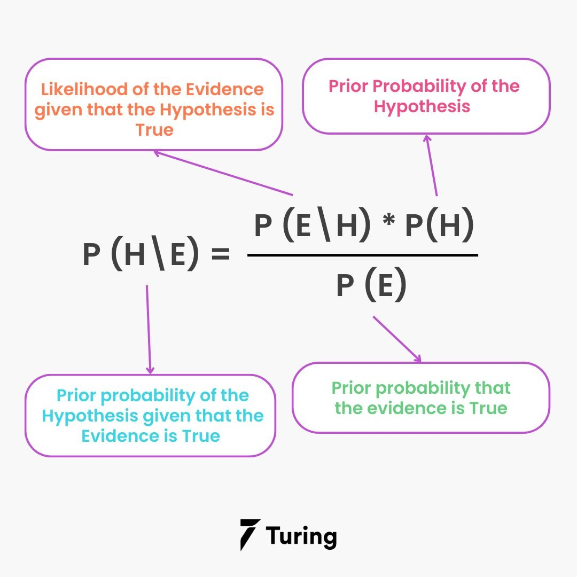
Naive Bayes Model - Visualizations
Visualizing the Naive Bayes model helps to better understand its inner workings and decision-making process. Intuitive graphs and charts can illustrate the key characteristics of this simple yet powerful probabilistic classifier.
Graphical representations of the model's probability distributions, feature importance, and classification boundaries provide valuable insights into the Naive Bayes approach.

Slide 41
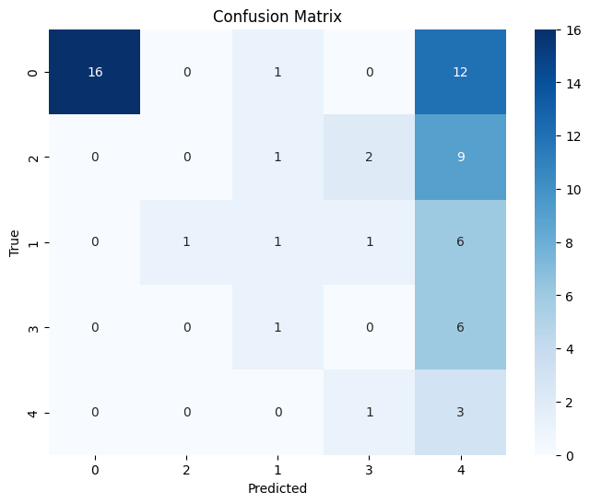
CONFUSION MATRIX (NAÏVE BAYES WITHOUT UPSAMPLING)

Slide 42
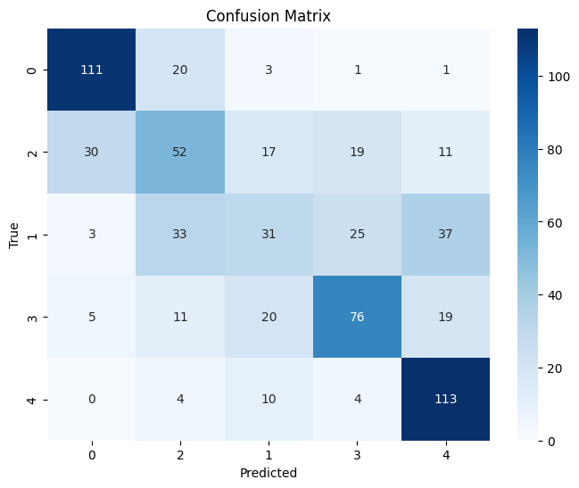
CONFUSION MATRIX (NAÏVE BAYES WITH UPSAMPLING)

Slide 43
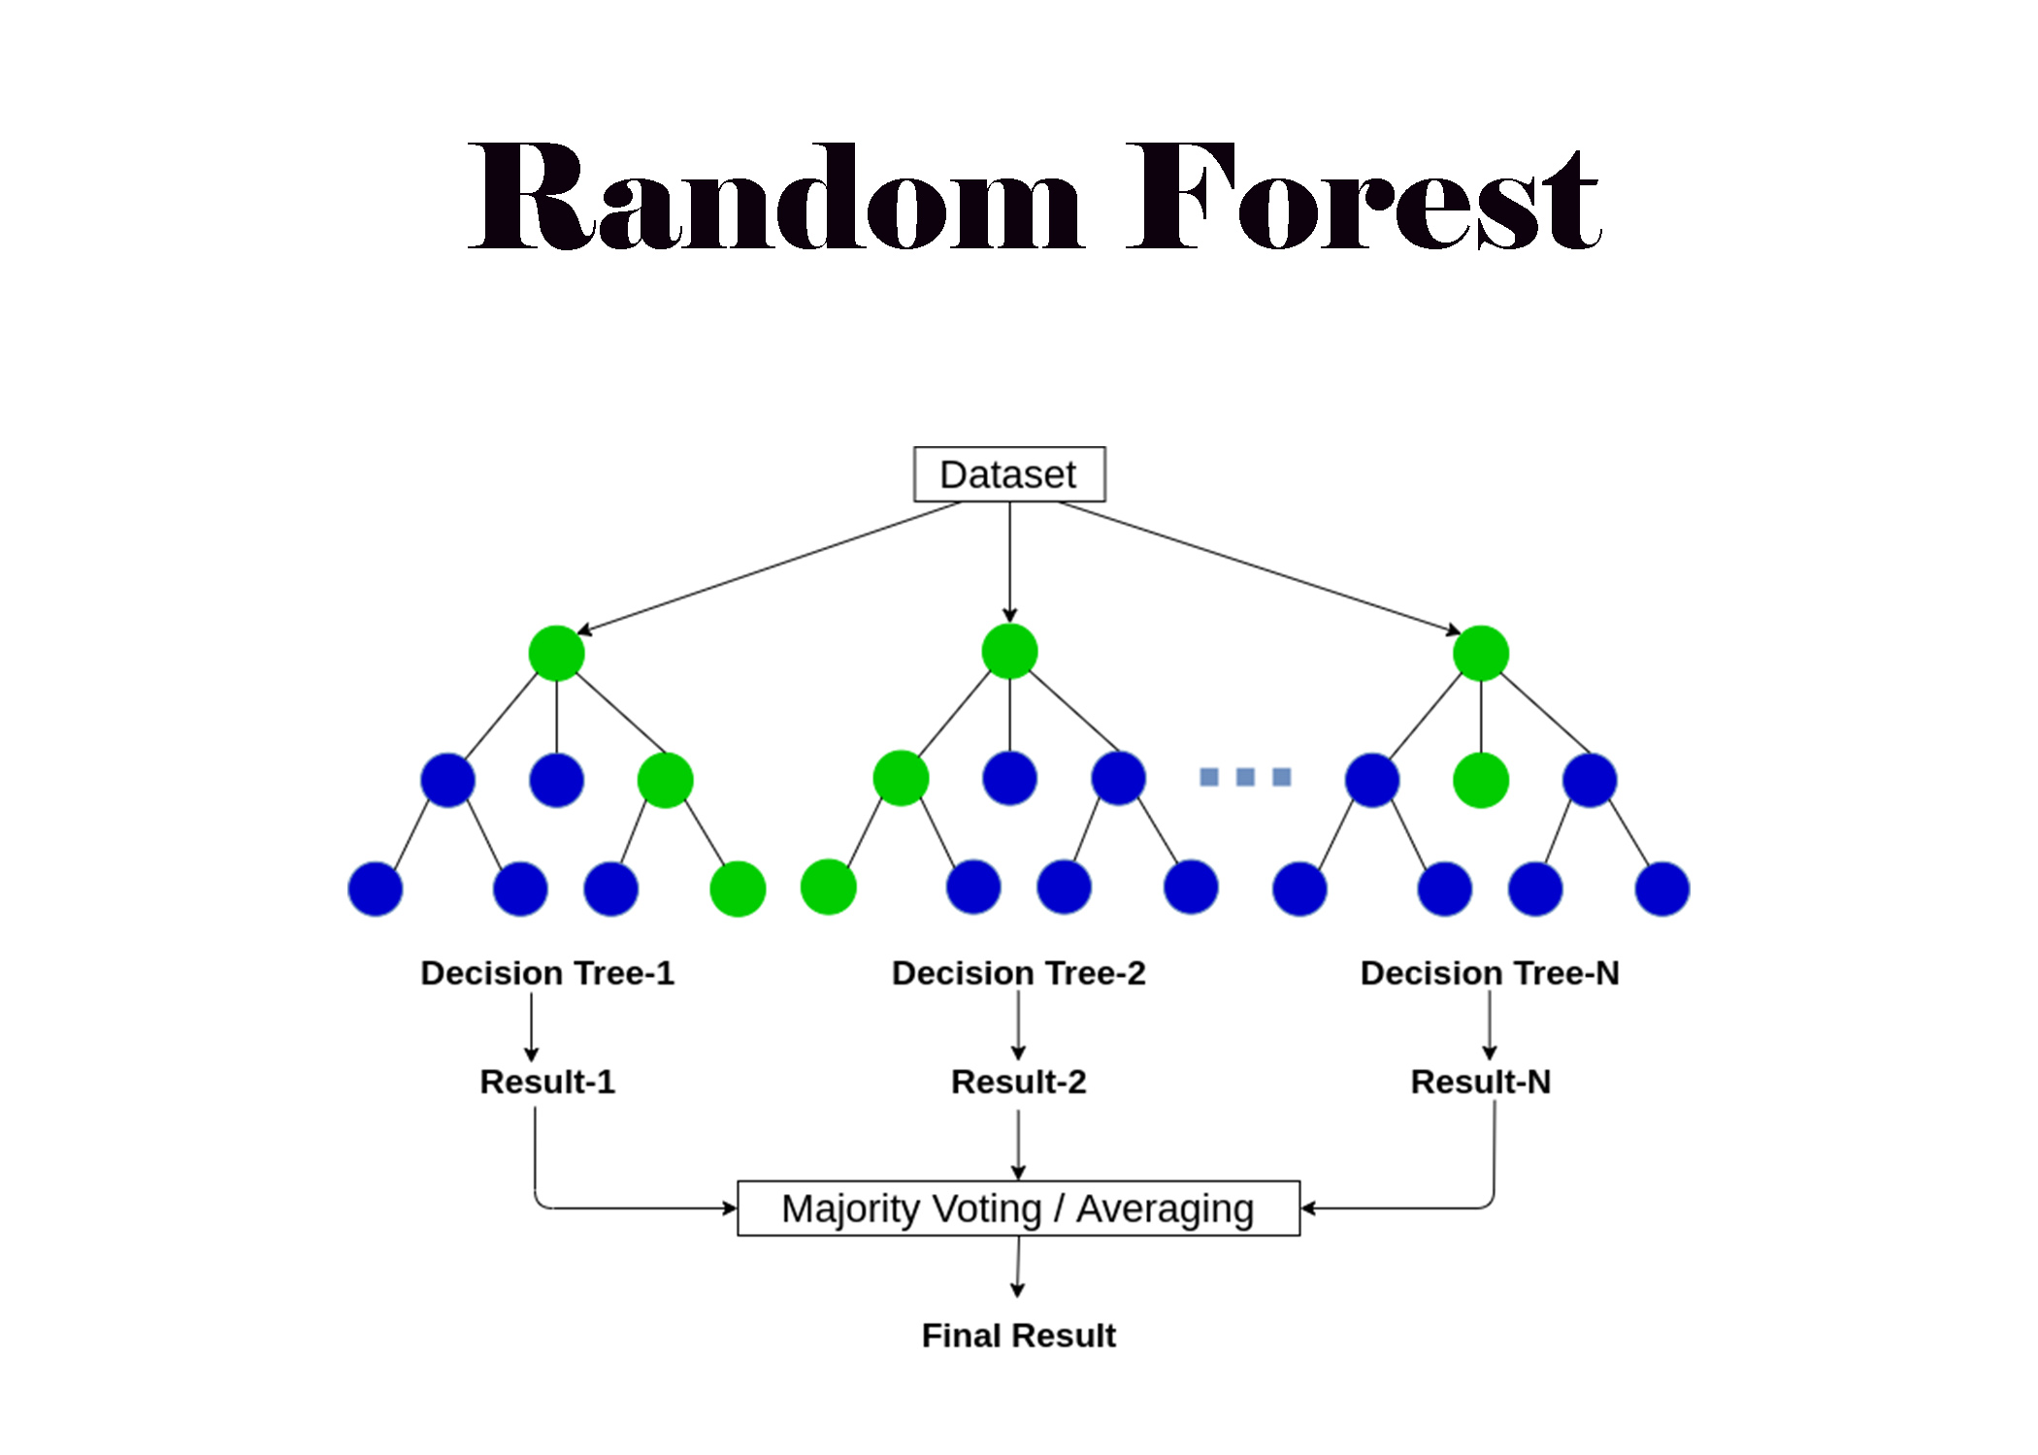
Random Forest Model
Random Forest is an ensemble learning method used for classification, regression, and other tasks. It constructs multiple decision trees during training and outputs the class that is the mode of the classes or the mean prediction of the individual trees.

Slide 44
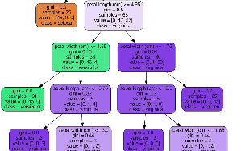
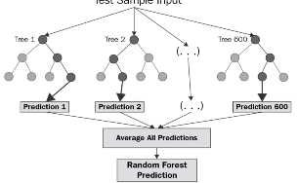
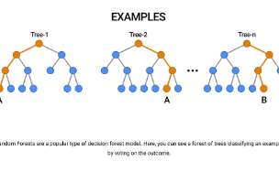
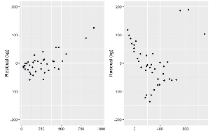
Random Forest Model
Decision Tree Visualizations
Feature Importance
Model Complexity
Error Analysis
Analyzing the errors made by the Random Forest model can uncover weaknesses in the data or model architecture, guiding further refinements.
Random Forest models are composed of multiple decision trees. Visualizing the structure and decision boundaries of these individual trees can provide valuable insights.
Examining the relative importance of different input features can reveal which factors the Random Forest model deems most critical for making accurate predictions.
Visualizing the complexity of the Random Forest model, such as the number of trees and tree depth, can help tune the model's performance and prevent overfitting.

Slide 45
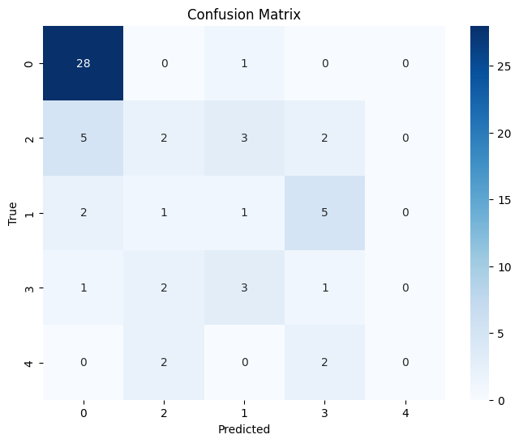
CONFUSION MATRIX (RANDOM FOREST WITHOUT UPSAMPLING)

Slide 46
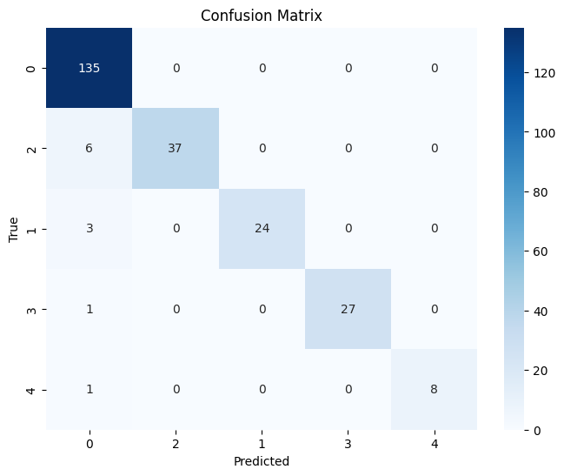
CONFUSION MATRIX (RANDOM FOREST WITH UPSAMPLING)

Slide 47

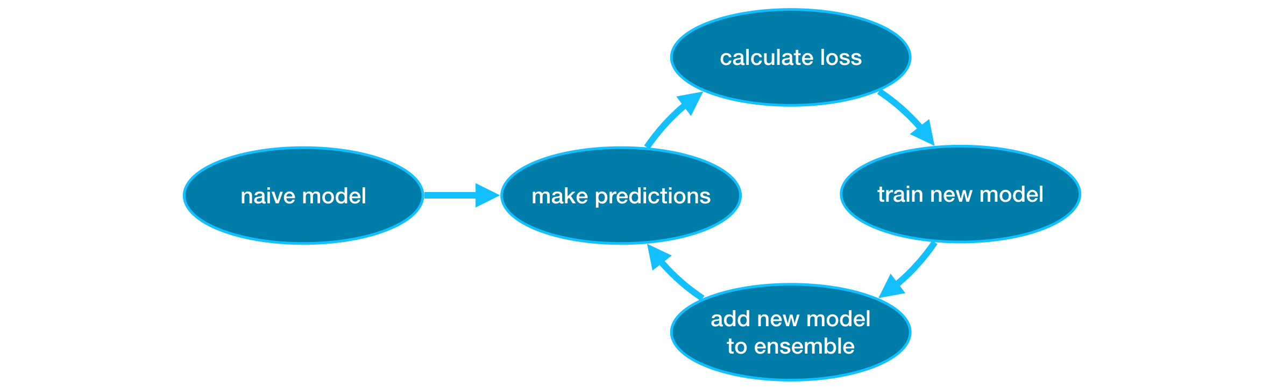
XGBoost Model
XGBoost is a powerful gradient boosting algorithm that has demonstrated impressive performance across a wide range of machine learning tasks. Its ability to handle complex, nonlinear relationships in data makes it a popular choice for classification and regression problems.

Slide 48
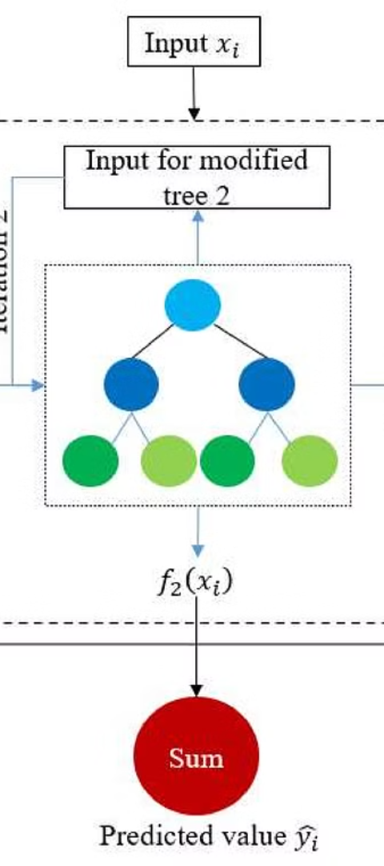
XGBoost Model
1
Feature Importance
Visualize the relative importance of each feature in the XGBoost model to understand which variables are driving the predictions.
2
Partial Dependence Plots
Plot the marginal effect of a feature on the model's output to see how the predicted outcome changes as a feature varies.
3
SHAP Value Plots
Leverage SHAP values to explain the impact each feature has on the prediction for a given data point, providing insights into the model's inner workings.

Slide 49
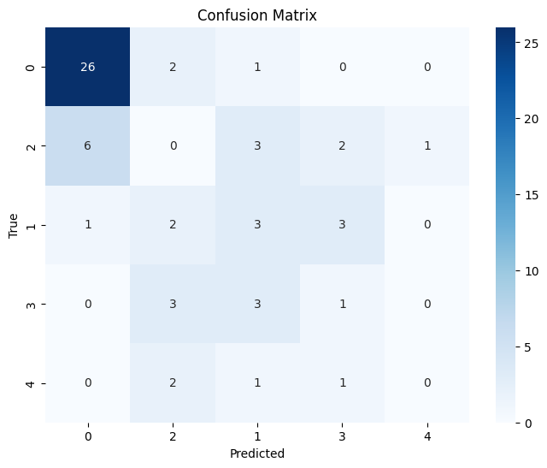
CONFUSION MATRIX (XgBoost WITHOUT UPSAMPLING)

Slide 50
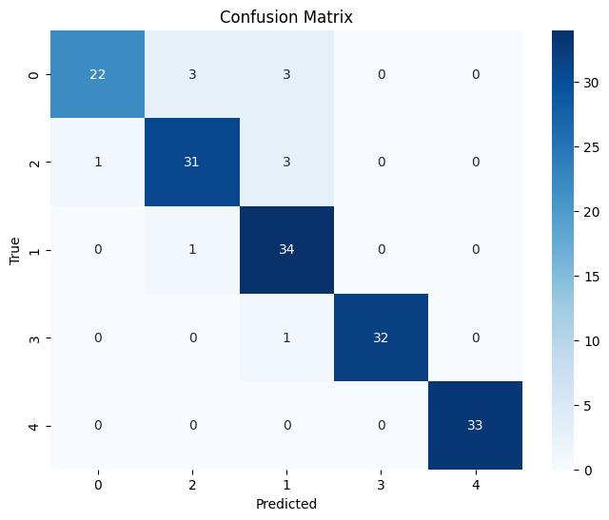
CONFUSION MATRIX (XgBoost WITH UPSAMPLING)

Slide 51

Artificial Neural Network (ANN)
Artificial Neural Networks (ANNs) are powerful machine learning models inspired by the human brain. They consist of interconnected nodes, or "neurons," that work together to process and learn from complex data.

Slide 52
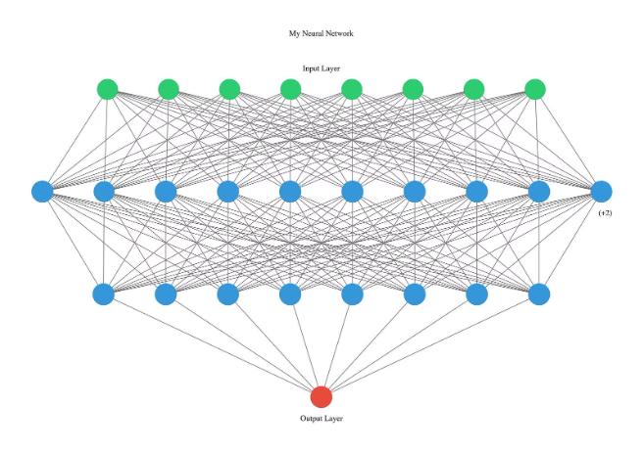
ANN Model - Visualizations
Visualizing the architecture and internal workings of an Artificial Neural Network (ANN) model can provide valuable insights. These visualizations often depict the interconnected layers of neurons, illustrating how the model learns complex patterns in data.
Techniques like heatmaps, layer activation visualization, and dimension reduction techniques like t-SNE can reveal the model's decision-making process, highlighting important features and their contributions to the final predictions.

Slide 53
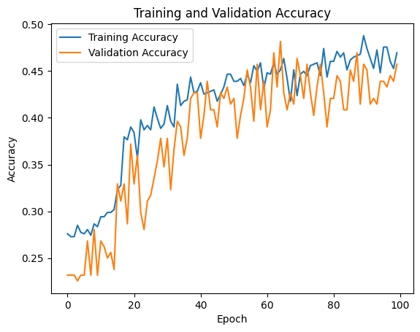
Trend with each EPOCH (Accuracy vs EPOCH)

Slide 54

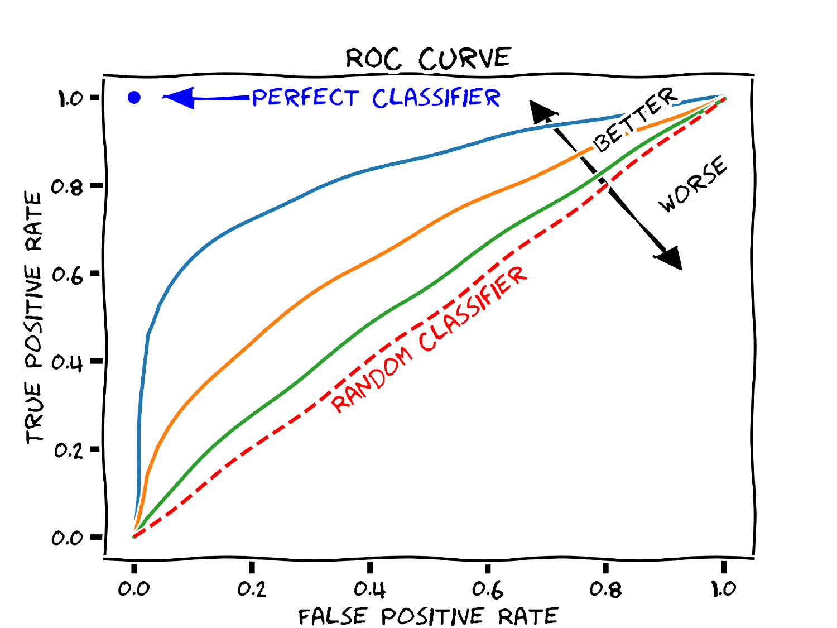
Introduction to ROC-AUC Curve
The Receiver Operating Characteristic (ROC) curve is a fundamental tool in machine learning and data science for evaluating the performance of binary classification models. It provides a visual representation of the trade-off between the true positive rate and the false positive rate of a model.
Aa

Slide 55
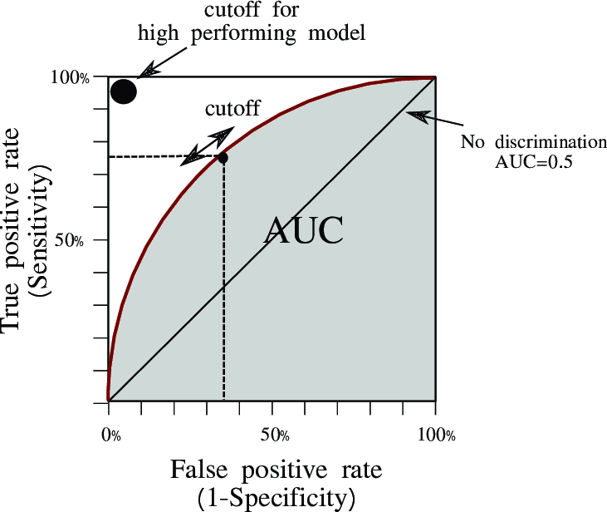
What is a ROC Curve?
The ROC curve plots the true positive rate (sensitivity) on the y-axis against the false positive rate (1 - specificity) on the x-axis. Each point on the curve represents a different decision threshold for the model, allowing you to assess the model's performance across different thresholds.

Slide 56
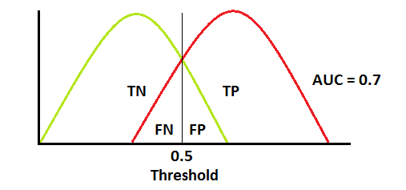
Calculating the ROC Curve
To calculate the ROC curve, you need to determine the true positives, false positives, true negatives, and false negatives for your model at different decision thresholds. From these values, you can compute the true positive rate and false positive rate to plot the ROC curve.

Slide 57
Interpreting the ROC Curve
1
Diagonal Line
2
Curve Shape
The diagonal line from (0,0) to (1,1) represents a random guess classifier, with an area under the curve (AUC) of 0.5.
The more the ROC curve bends towards the top-left corner, the better the model's performance. An AUC close to 1 indicates an excellent classifier.
3
Threshold Selection
The ROC curve helps you choose the optimal decision threshold based on your specific needs, such as balancing sensitivity and specificity.

Slide 58
Advantages of the ROC-AUC Curve
Threshold-Independent
Intuitive Interpretation
Imbalanced Data
The ROC curve provides a comprehensive view of a model's performance, independent of the chosen decision threshold.
The ROC curve and its associated AUC metric are easy to interpret, making it a widely used and understood evaluation technique.
ROC-AUC is a robust metric that works well even with imbalanced datasets, unlike accuracy which can be misleading.

Slide 59
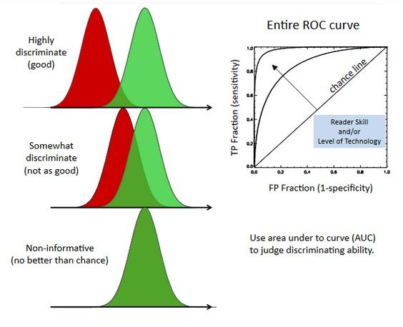
Limitations of the ROC-AUC Curve

Slide 60



Applications of the ROC-AUC Curve
Medical Diagnosis
ROC-AUC is widely used in medical applications, such as evaluating the performance of diagnostic tests for diseases.
Credit Risk Assessment
ROC-AUC is used in financial applications to assess the creditworthiness of customers and make lending decisions.
Fraud Detection
ROC-AUC is a crucial metric in fraud detection systems, where it helps identify fraudulent transactions effectively.

Slide 61
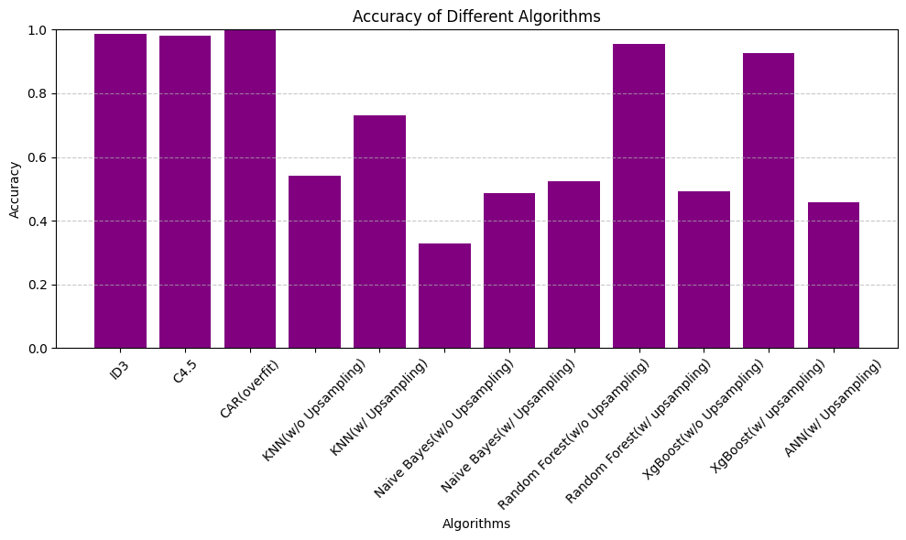
Comparison of all The Models

Slide 62
CONCLUSION
In conclusion, our exploration into heart disease classification using machine learning algorithms has demonstrated promising results and potential for significant impact in healthcare. By leveraging various features and datasets, we have shown the effectiveness of machine learning models in accurately predicting the presence of heart disease. Through rigorous evaluation and validation techniques, we have highlighted the reliability and robustness of our models in real-world scenarios.
Furthermore, efforts should be directed towards addressing challenges such as data privacy, model transparency, and bias mitigation to foster trust and acceptance within the medical community.

Slide 63
RFERENCES
DATASET
https://archive.ics.uci.edu/dataset/45/heart+disease
ID3, CART, C4.5
https://colab.research.google.com/drive/13r86rOJnmENV705-JglWd1Hlwpqpvlpu
DATSET PREPOCESSING
https://colab.research.google.com/drive/1mn-AgC7qZW3Qs6C6Kh7xnvPIe6wkIKaX
KNN
https://colab.research.google.com/drive/1F51fFDQiQhvccap6ejZJLv_syRpCFtUn
Naïve Bias
https://colab.research.google.com/drive/1KYbqSc0cR5M_LIlNKf35vBUIw-aXaCnh
RANDOM FORSET AND X G Boost
https://colab.research.google.com/drive/1ON4xXhfM4jkFOWCJzS0A2t9hQvYEZ3IP

